Slide 1
^{Same-Sex Marriage}
^{Still Under Attack}
© April 2018, Demian
Partners Task Force for Gay & Lesbian Couples
Notes:
Same-Sex Marriage
© 2000, Partners Task Force for Gay & Lesbian Couples
Partners, Box 9685, Seattle, WA 98109 206-935-1206 www.buddybuddy.com

Slide 2
Marriage Is Good
Marriage equality is about love.
Choice of a life-partner is a fundamental right.
Marriage must be available to all adults.
60 percent of U.S. gay men and lesbians are in a relationship.
Legally supported couples are better able to provide care for each other, and their children.
Supported couples are better able to contribute to the community.
[ See: “Legal Marriage Primer - Read This If You Don’t Read Another Thing About Legal Marriage” by Demian, Partners Task Force for Gay & Lesbian Couples, May 21, 2009 ]

Slide 3
How to Determine
Male and/or Female?
Anti-gay discrimination is based on appearances, not on actually being being male, female, or on sexual identity.
There’s no truly accurate way to determine a person’s biological sex; even using chromosome assessment, or body inspection.
Not even the International Olympic Committee has a definitive way to determine a person’s sex, based on anatomy, reproductive system, secondary sex characteristics, or genetics.
[ See: “Olympic Games and the tricky science of telling men from women” by Jon Bardin, Los Angeles Times, July 30, 2012 ]

Slide 4
Legal Battles
[ Slogan by John Wilkinson, Legal Marriage Alliance of Washington, 1996.
See: “Marriage Bumper Sticker Ideas”
from Partners Task Force for Gay & Lesbian Couples ]

Slide 5
Before Supreme Court:
Obergefell v. Hodges
Blacks, Asians, and Native Americans were denied legal marriage during America’s early years.
Married women were not allowed to make legal contracts in 12 American states until 1940.
By 1958, 24 states still prohibited interracial marriage. Twelve states prohibited them until 1967, when it was finally ruled unconstitutional (Loving v. Virginia).
Same-sex marriage had always been banned in the U.S., until Massachusetts became the first state to offer legal marriage equality in 2004.
By 2015, 37 American states had legalized marriage equality for same-sex couples.
Other countries offering legal marriage in 2015:
Netherlands (2001), Belgium (2003), Canada (2005), Spain (2005), South Africa (2005), Norway (2009), Sweden (2009), Iceland (2010), Argentina (2010), Portugal (2010), Denmark (2012), France (2013), New Zealand (2013), Brazil (2013), Uruguay (2013), New Zealand (2013), United Kingdom (England, Wales, Scotland) (2013), Luxembourg (2014), Finland (2014), Ireland (2015), United States (2015), Colombia (2016), Germany (2017), Taiwan (2017), Malta (2017), Australia (2017).
[ See: “Marriage Traditions in Various Times and Cultures”
by Demian, Partners Task Force for Gay & Lesbian Couples, 2011 ]

Slide 6
Defending Against the
“Defense of Marriage Act”
The first U.S. federal anti-marriage law ever made was called the “Defense of Marriage Act” (DOMA).
Enacted in 1996, it extended federal power to define legal marriage, a power it never had before.
Previously, the federal system only made laws that were triggered by legal marriage.
“DOMA” prevented the federal system from recognizing any status “between persons of the same sex that is treated as a marriage.” And, second, it defined the words “marriage” as “only a legal union between one man and one woman as husband and wife,” and the word “spouse” as “a person of the opposite sex who is a husband or a wife.”
This law allowed states to refuse recognition of legal same-sex marriages from other states.

Slide 7
“DOMA” Never Defended Anything
Denying recognition of legal marriages between same-sex partners trashed the Constitutional “Full Faith and Credit” guarantee.
Most scholars agreed that it is not constitutional because it violated the state right to define marriage.
DOMA codified a second-class status.
One part of the “Defense of Marriage Act” was ruled unconstitutional on June 26, 2013.
It continued to be used as a state legislative model to restrict legal marriage in more than 40 states.
[ See: “Defense of Marriage Act - The Destruction of Certain Families Act” by Demian, Partners Task Force for Gay & Lesbian Couples, May 28, 2015 ]

Slide 8
Marriage for Same-sex
Couples Finally Legalized
On June 26, 2015, the United States Supreme Court declared – in Obergefell v. Hodges – that denying same-sex couples the freedom to marry violated the U.S. Constitution.
The finding stated that same-sex couples deserved the right to marry due to both the “Due Process Clause” and the “Equal Protection Clause” of the Fourteenth Amendment to the Constitution.
The ruling meant that all 50 states must lawfully perform and recognize the marriages of same-sex couples, on the same terms and conditions, as the marriages of opposite-sex couples, with all the accompanying rights and responsibilities.
This decision ended a 47-year battle – begun by individual life partners – to extend the freedom to marry to same-sex couples nationwide.
Notes:
Same-Sex Marriage
© 2000, Partners Task Force for Gay & Lesbian Couples
Partners, Box 9685, Seattle, WA 98109 206-935-1206 www.buddybuddy.com

Slide 9
Revenge of the
Extremists

Slide 10
After
Obergefell v. Hodges
Immediately following the Supreme Court ruling, counties in three states broke the law, denying legal marriage for same-sex couples.
On June 26, 2017, the Supreme Court reaffirmed its 2015 decision and ruled, in Pavan v. Smith, that states may not treat married same-sex couples differently from others in issuing birth certificates.
Since 2013 — two years before the right to marry was obtained — there has been a record-breaking introduction of at least 348 anti-gay bills in many U.S. states. These include:
134 based on “religious” exemptions, 70 in order to segregate transgender peoples, 81 in order to refuse marriage to same-sex couples, and 63 miscellaneous anti-gay laws.
Of those bills, 23 were signed into law. As of June 29, 2017, there were still 48 active bills.
[ See: “The Dramatic Rise in State Efforts to Limit LGBT Rights” by Everdeen Mason, Aaron Williams, Kennedy Elliott, Washington Post, July 1, 2016 ]
Notes:
Same-Sex Marriage
© 2000, Partners Task Force for Gay & Lesbian Couples
Partners, Box 9685, Seattle, WA 98109 206-935-1206 www.buddybuddy.com

Slide 11
What State Anti-Marriage
Laws Really Accomplish
Don’t protect even one marriage, or family.
They divide people.
Used as legal rationale to deny other benefits, such as health insurance and custody.
Consolidates power by right-wing extremists.
Couples married in one state, or country, become legal strangers in others, creating a legal chaos.

Slide 12
Presidential Animus
U.S. president Donald Trump has taken hateful actions against LGBT people:
Nominated Federal judges who lack qualifications and the temperament to serve fairly and without bias.
Judges hand-picked by the ultra-conservative Heritage Foundation and Federalist Society; many of candidates want to halt same-sex marriage.
Republicans approve these ideologue candidates.
Denied immigration to legally married partners in bi-national same-sex marriages.
Removed gay men and lesbians from the National Census, which affects funding and laws.
Notes:
Same-Sex Marriage
© 2000, Partners Task Force for Gay & Lesbian Couples
Partners, Box 9685, Seattle, WA 98109 206-935-1206 www.buddybuddy.com

Slide 13
Presidential Anti-LGBT Actions
Donald Trump’s administration has taken hateful actions against LGBT people:
Attempted to ban Transgender personnel from military.
HUD removed Anti-Discrimination Language from their Mission Statement.
Creation of “Conscience and Religious Freedom Division” (Health and Human Service’s Office of Civil Rights), which allows refusal of medically necessary health care in the name of religion. Consequences range from life endangerment, to harassment, and also potential damage to public health.
The Department of Education no longer investigates civil rights complaints from transgender students, often about access to bathroom facilities.
In February 2018, president Trump and the federal Departments of Education and Justice rescinded guidance that clarified federal legal protections for transgender students.
Notes:
Same-Sex Marriage
© 2000, Partners Task Force for Gay & Lesbian Couples
Partners, Box 9685, Seattle, WA 98109 206-935-1206 www.buddybuddy.com

Slide 14
Vice-Presidential Animus
As a representative, the now vice president Mike Pence gave a speech on the House floor in 2006, in which he urged support for the anti-gay “Marriage Protection Act,” warning that same-sex marriage would lead to the “deterioration of the family” and, ultimately, complete and utter “societal collapse.”
Pence has spoken out against giving LGBT people federal protections in hate crimes legislation, and literally called enhanced penalties and increased investigations of hate-based crimes against gay men and lesbians “a radical social agenda.”
Pence stated on his 2000 campaign Website that Congress should oppose any effort to recognize homosexuals as a “discreet and insular minority” entitled to the protection of anti-discrimination laws similar to those extended to women and ethnic minorities.
In 2016, as Indiana governor, Pence signed a “religious liberty” bill into law that would create exemptions for hiring, or serving, LGBT people in businesses, based on the employers’ or business owners’ religious beliefs.
[ See: “Mike Pence’s Beliefs Are Clear:Same-Sex Marriage Leads To ‘Societal Collapse’ ” by Michelangelo Signorile, Huffington Post, February 16, 2018 ]
Notes:
Same-Sex Marriage
© 2000, Partners Task Force for Gay & Lesbian Couples
Partners, Box 9685, Seattle, WA 98109 206-935-1206 www.buddybuddy.com

Slide 15
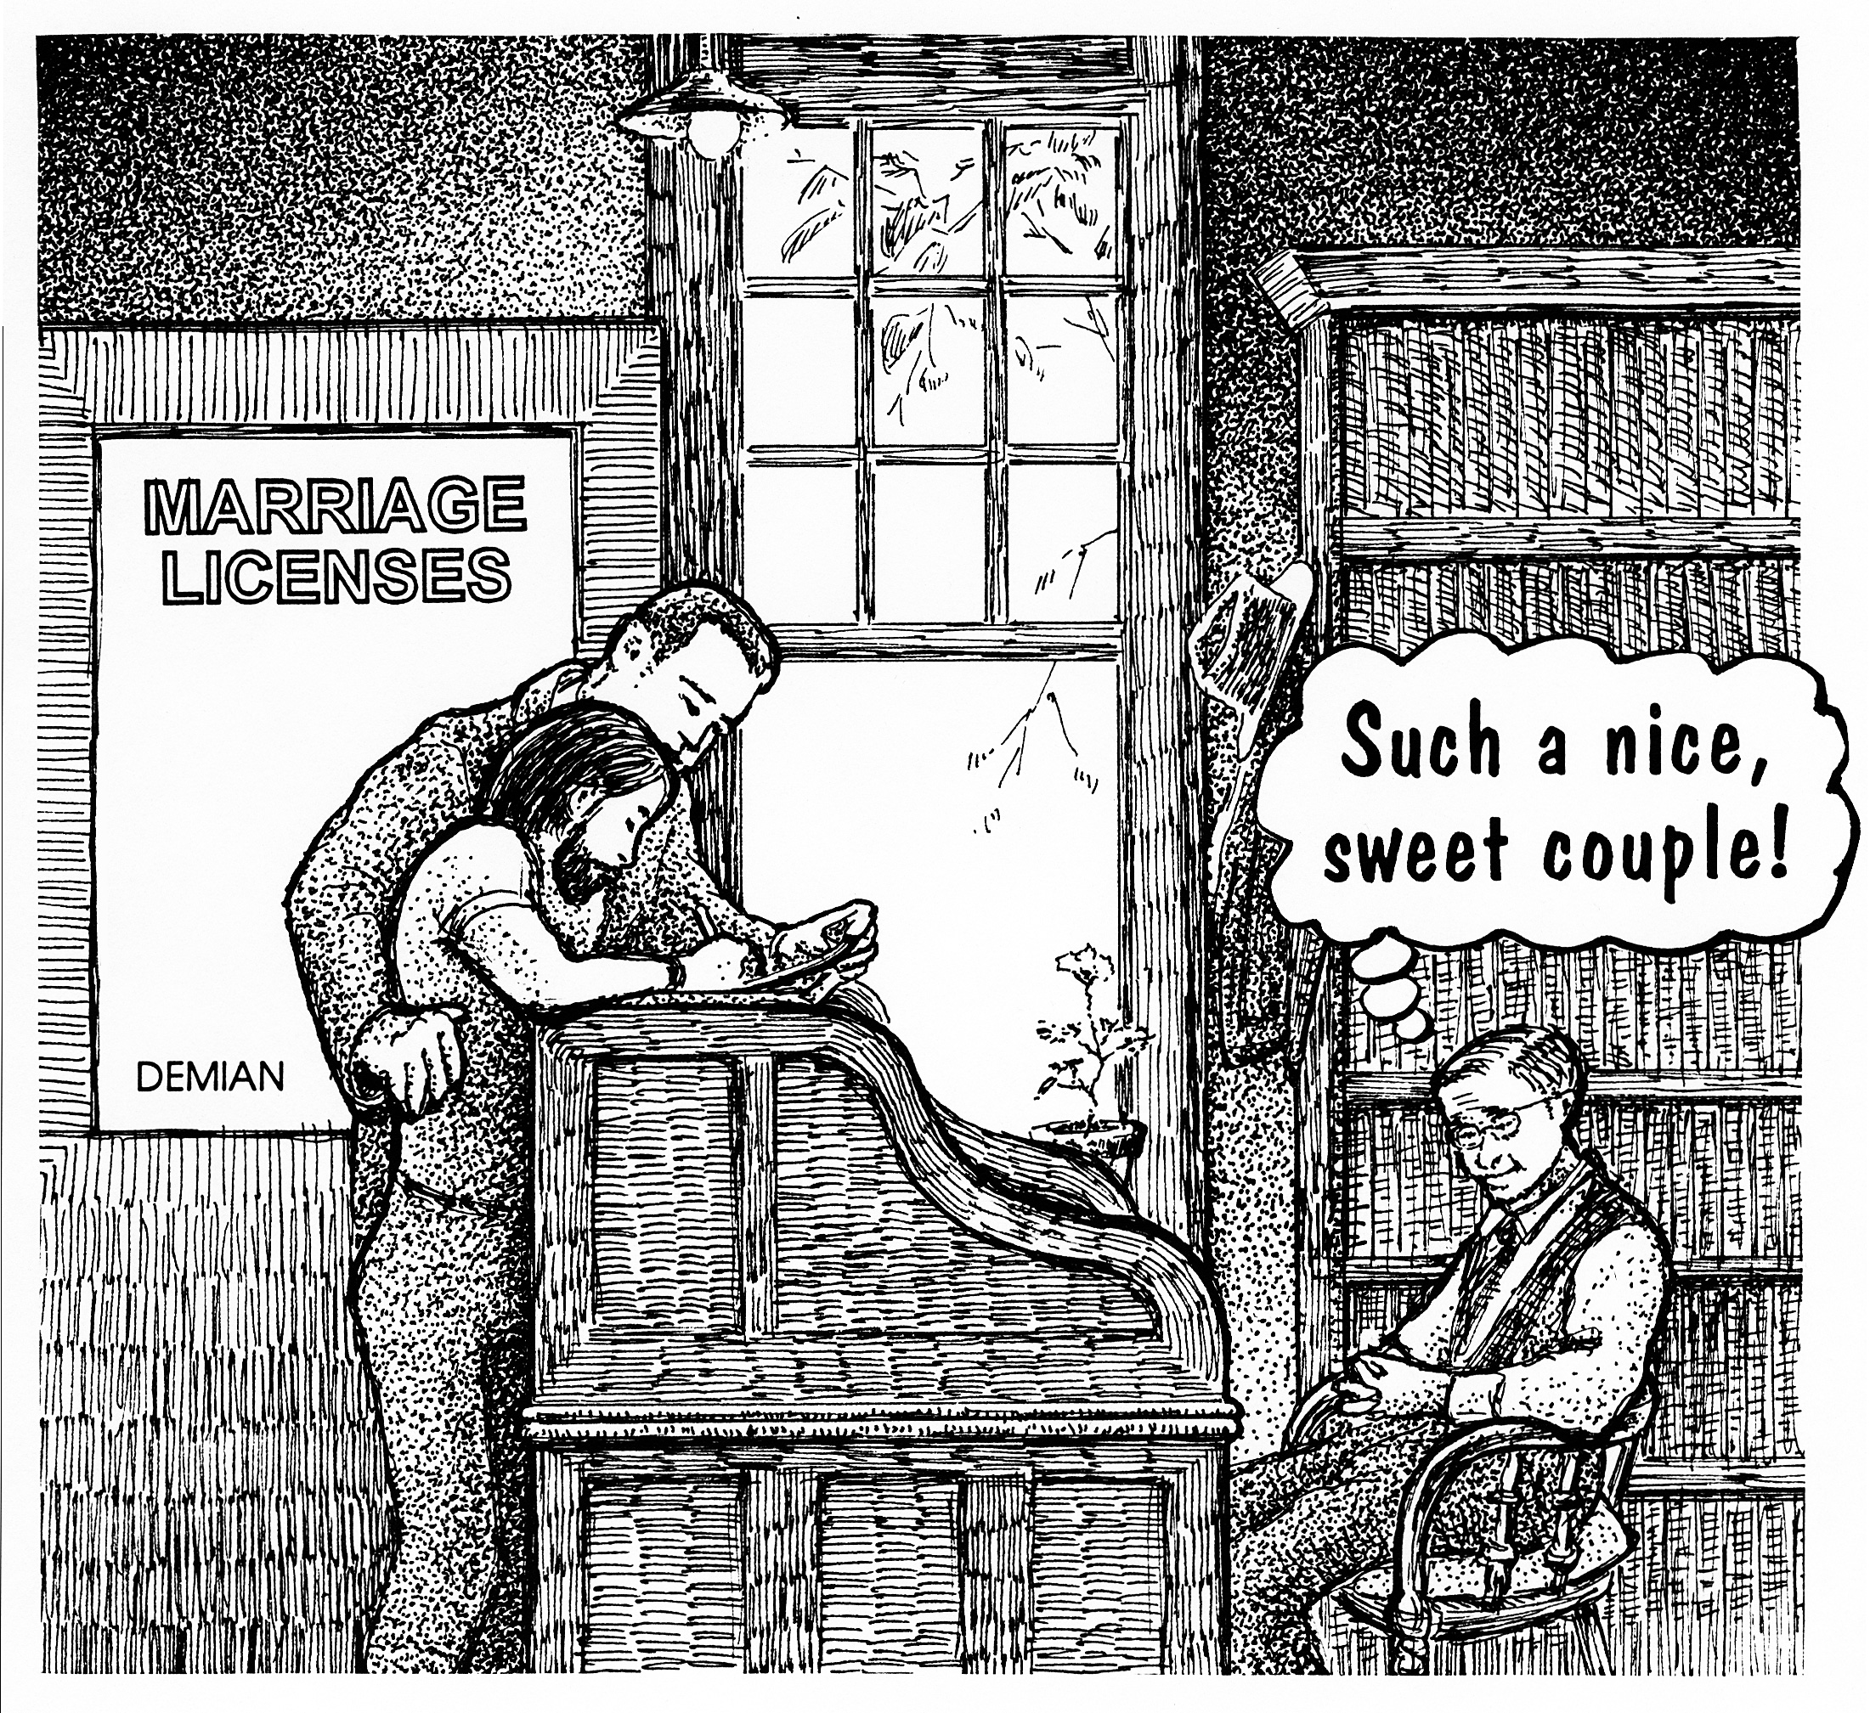
What You Can Do

Slide 16
How You Can Help
The struggle to maintain legal marriage for same-sex couples is not over.
Talk about these issues with friends, relatives, and co-workers; tell them how important legal marriage is to you and the health of the nation.
Write about these issues to your elected representatives, other leaders, and the media; especially whenever your legislature mounts a bill to curtail the right to marry.
Narrate, in person, this document to your school, social, and spiritual groups.
Celebrate your family anniversaries publicly.

Slide 17
Celebrate Your Family
Send notices to your local paper or blog when you marry, have an anniversary, or a child.
Note:
The word “Family” means two or more people who share their lives, bound together by love.
“Family” is shaped by how we treat each other.
Same-sex couples are already families. A legal marriage brings legal support.
Committed, adult couples have the constitutional right to benefits, protections, and the duties of legal marriage.
About 60 percent of U.S. gay men and lesbians are in a relationship.

Slide 18
Family Values
Same-sex marriage demonstrates and fulfills all the ideals of conservative family values: long term social stability, loving families, protecting children, legal status for children, economic growth through establishing a home, as well as expanding the sanctity and wholesomeness of the institution of marriage.
When loving same-sex families are protected by marriage law, during times of crisis, they and our communities, are stabilized.
“Family Values” means “All Families Have Value.”

Slide 19
Resources
American Civil Liberties Union (ACLU) 212-549-2500; LGBT Relationships aclu.org/lgbt-rights Fights for privacy, legal same-sex marriage, and against rights violations.
Immigration Equality 212-714-2904 x25; legal@immigrationequality.org; immigrationequality.org Fights for equal immigration rights, as well as assisting LGBT and HIV+ refugees.
Lambda Legal 212-809-8585; Help Desk lambdalegal.org/help/form; lambdalegal.org Assistance with legal matters of sexual orientation, gender identity or HIV.
National Center for Lesbian Rights (NCLR) 415-392-6257; info@nclrights.org; nclrights.org Committed to advancing civil and human rights for lesbian, gay, bi, trans people and their families via litigation, public policy advocacy, and public education.
National LGBTQ Task Force 202-393-5177; TTY 202-393-2284; thetaskforce@thetaskforce.org; thetaskforce.org Educates, advocates and organizes for full societal recognition of lesbian and gay relationships, and for the protection of lesbian and gay families.

Slide 20
Partners Task Force for Gay & Lesbian Couples
Partners is an international resource for same-sex couples, supporting the diverse community of committed gay and lesbian partners through a variety of media since 1986.
The constantly updated Web site contains more than 450 essays, surveys, legal articles and resources on legal marriage, ceremonies, domestic partner benefits, relationship tips, parenting, and immigration.
The Web site is frequently accessed by couples, counselors, clergy, personnel staff, reporters, researchers, students and government officials.
Demian, Ed.D., director buddybuddy.com
This article was written by Demian, with editorial assistance from Janice Van Cleve and James Brumbaugh.
Notes:
Same-Sex Marriage
© 2000, Partners Task Force for Gay & Lesbian Couples
Partners, Box 9685, Seattle, WA 98109 206-935-1206 www.buddybuddy.com

